Slide 1

Team SEWZ: Project report
Shouyu Ling, Eric Chang, Wei Shao, Zorry Belchev

Slide 2
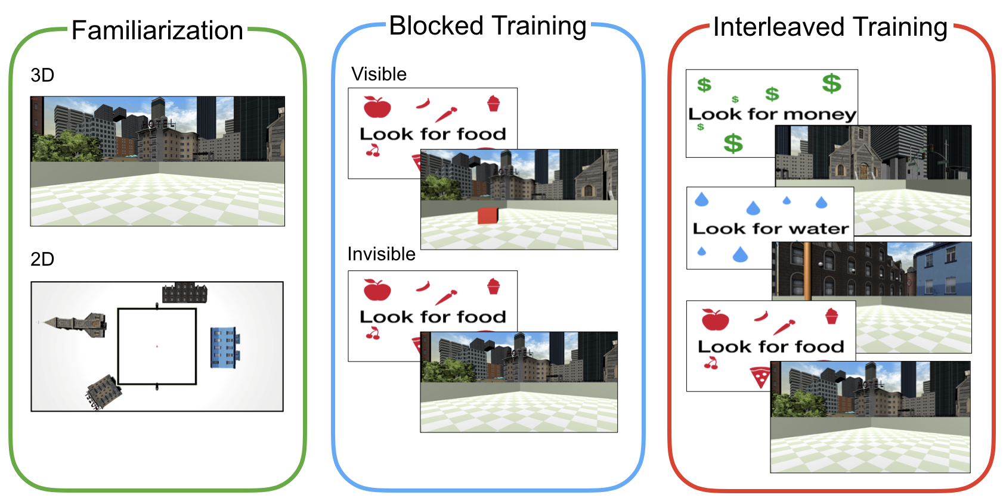
Experiment overview: Training Phase
1
2
3
Environment
Rural
Urban
Reward Type
Food
Water
Money
Analyses only based on invisible trials

Slide 3
Predict performance on Block 3
Regression model based on invisible trials
Block 3 Performance
Block 2 Performance
Environment Type
2: Rural
3: Urban
Reward Type
Food
Water
Money

Slide 4
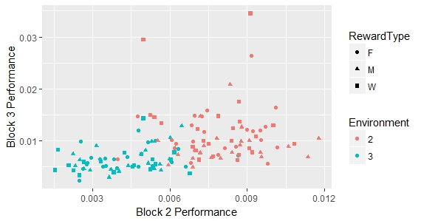
Predict performance on Block 3
Regression model : Results
REML criterion at convergence: -1079.9
Variable | F | p
Block2Performance | 0.69 | .41
Environment | 13.87 | .0003
RewardType | 2.12 | .12

Slide 5
Predict performance on Block 3
Follow-up analysis separated by environment
Environment: Rural
Environment: Urban
Block 3 Performance
Block 3 Performance
Block 2 Performance
Block 2 Performance

Slide 6
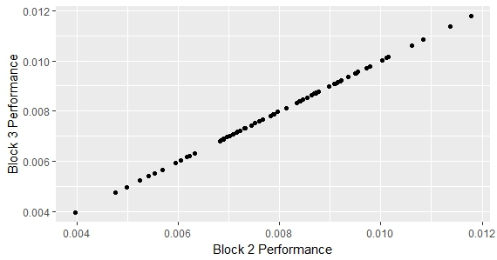
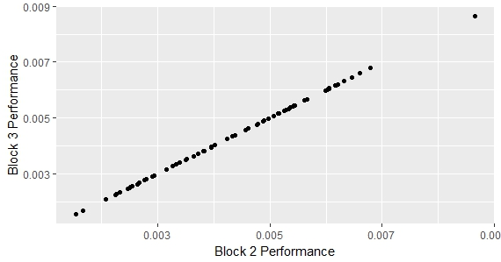
Predict performance on Block 3
Follow-up analyses: Results
Variable | F | p
Block2Performance_Rural | 5.92e+33 | <.0001
Block2Performance_Urban | 2.04e+33 | <.0001

